Slide 1
Message Construction
Srikanth Gunturu
Guest Faculty
BITS, WILP

Slide 2
In this segment
Message Construction
Command Message
Document Message
Event Message
Request-Reply
Return Address
Correlation Identifier
Message Sequence
Message Expiration
Format Indicator

Slide 3
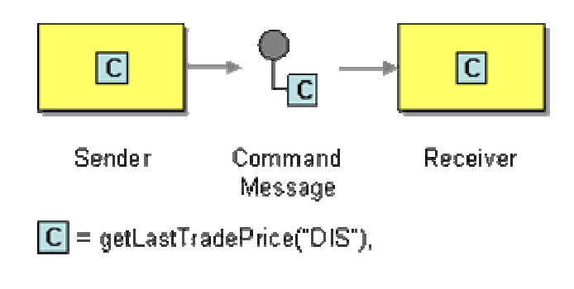
Message Construction
Command Message
Command Message is used to invoke a procedure in another application, reliably.
Asynchronous invocation of procedures, as opposed to RPC
Message contains command for the other application, there’s no other specific indication on message
Usually sent on point-to-Point channel
Ex: SOAP messages

Slide 4
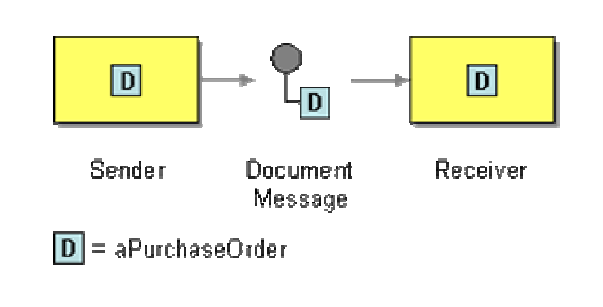
Message Construction
Document Message
Document Message is used to reliably transfer a data structure between applications
Can contain any kind of message in the system, except that it represents a data object
Usually sent on a point-to-point channel
Ex: XML documents sent across the network

Slide 5
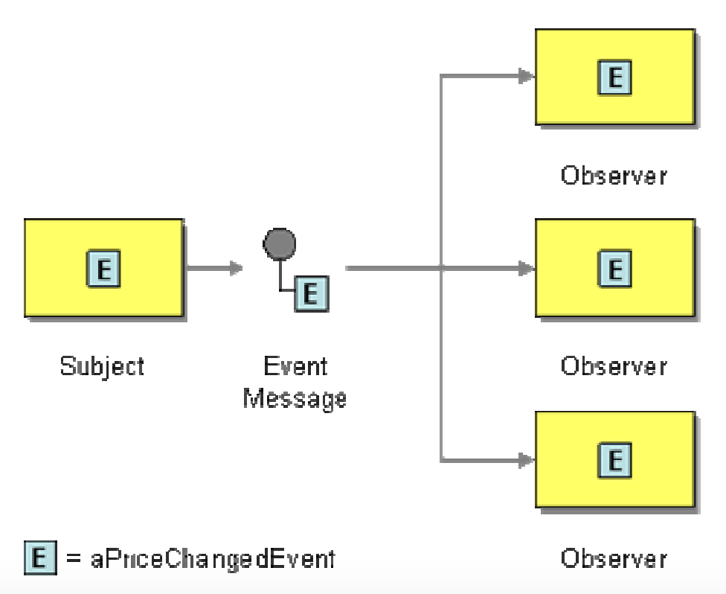
Message Construction
Event Message
Document Message is used to reliably send event notifications between application
Sender will create an event object and sends it in a message (no special indicator used)
Push model – sends event and the related state change info
Pull model – sends only the event details and optionally additional info to obtain state details
Update
State Request
State Reply

Slide 6
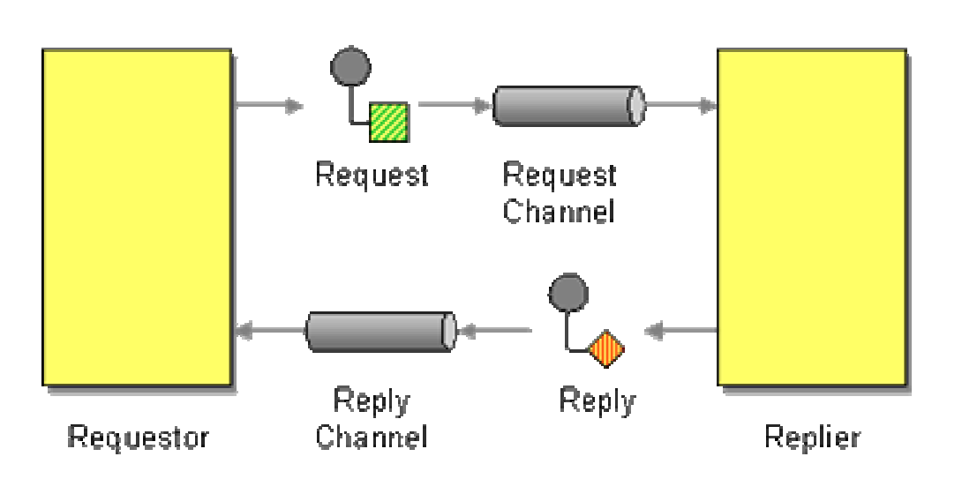
Message Construction
Request-Reply
Facilitates two way communication between sender/receiver using two-way channel
Requestor – sends request message and waits for reply
Replier – receives request message and sends the reply
Request channel could be point-to-point or publish-subscribe
Reply channel is almost always point-to-point
Reply can be:
Synchronous (blocking)
Asynchronous (callback)

Slide 7
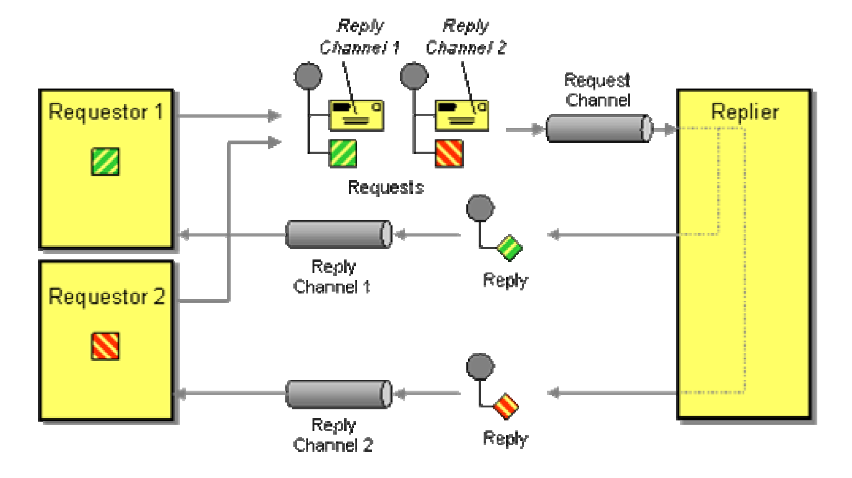
Message Construction
Return Address
Asynchronous request-reply model has callback mechanism, which needs the receiver to know where to send the response, especially with multiple senders in question
Return Address is supplied along with the Request Message, that will be used by receiver to send the reply back (Ex: JMS – JMSReplyTo field on request object)

Slide 8
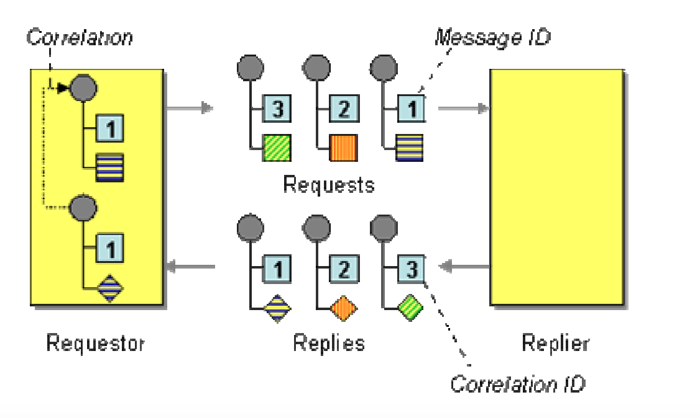
Message Construction
Correlation Identifier
Each reply in request-reply model should contain a Correlation Identifier that uniquely indicates a which request this reply is for.
Correlation Identifier has 6 parties to it:
Requestor – Sender App
Replier – Replier App
Request – Contains Request ID
Reply – Contains Correlation ID
Request ID – A unique token from the request
Correlation ID – Unique token in response copied from Request ID
Correlation ID (and even Request ID) are specified in respective message headers
Ex: JMS - JMSCorrelationID and JMSMessageID

Slide 9
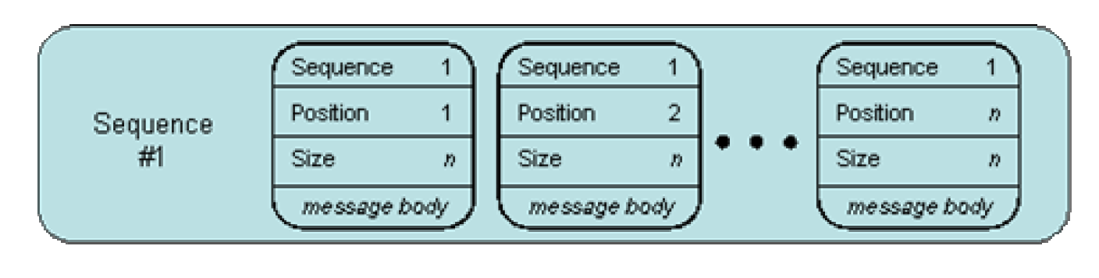
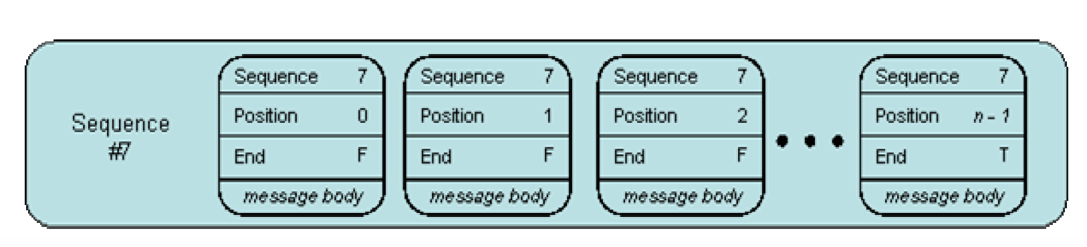
Message Construction
Message Sequence
Message Sequence is used whenever a large set of data may need to be broken into message-size chunks
Each message in Message Sequence is marked with sequence identification fields
Message Sequence identification fields
Sequence identifier
Position identifier
Size or End indicator
Example Use cases:
Large document transfer
Multi item query
Distributed query

Slide 10
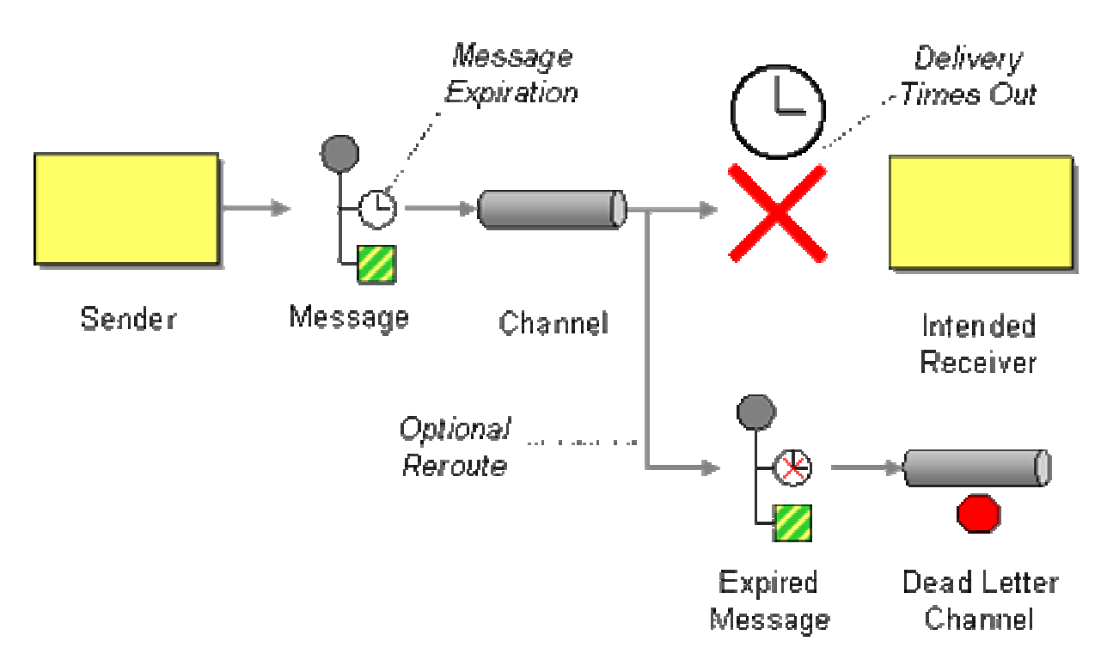
Message Construction
Message Expiration
Message Expiration sets the time limit after which the message becomes stale
One the time limit expires, the message is not considered by consumers for processing, moved to Invalid Message Channel
It could be configured to be rerouted to Dead Letter Channel for further handing
Message Expiration is a timestamp
Relative (longevity), using sent time property
Absolute
JMS implementation - MessageProducer.setTimeToLive(long)

Slide 11
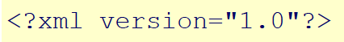
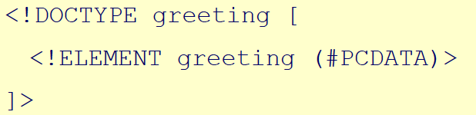
Message Construction
Format Indicator
The format indicator enables the sender to tell the receiver the format of the message
This handles versioning and future changes
Format indicator can be implemented as:
Version Number
Foreign Key
Format Document

Slide 12
Thank You!
In our next session:
Message Routing

